Slide 1


Mini Project under the aegis of Department of CEA
Presented by:
Piyush Kumar
Nitin Sikarwar
Sumit Kumar Swain
Mentor:
Mr. Shamsher Khan

Slide 2
NightWatch An Intelligent EDR Framework

Slide 3
Problem
Endpoints are primary targets for:
Malware & ransomware
Credential theft
Persistence techniques
Lateral movement
Issues with existing EDR tools:
Expensive & complex
Closed-source / not customizable
Heavy on system resources
Need: A lightweight, Python-based EDR that teams can extend and deploy easily.

Slide 4
Proposed
Solution
Goal: Simple, modular, open design suitable for real-world use.
A complete EDR ecosystem with four core components:
Python Agent — Collects telemetry from endpoints
FastAPI Server — Receives, stores, and processes data
Rule Engine — Detects malicious behavior using flexible rules
Web Dashboard — Visualizes alerts, endpoints, and rule management

Slide 5
Agent Capabilities
System Monitoring
Security Monitoring
Config & Resilience
Processes (PID, PPID, CPU, memory, command line)
File system events (create/delete/modify/rename)
Network connections (IP, ports, states)
Windows Event Logs (logon, process creation)
SHA-256 hashing of executables
Local hash reputation check
JSON config (intervals, sensors, server URL)
Local queue for offline mode
Automatic retry & error logging

Slide 6
Server Capabilities
Core Functions
Security
Data Storage
Agent registration & heartbeat
Telemetry ingestion APIs
Alert creation & storage
Rule storage and evaluation
Token auth for agents
User login for dashboard
HTTPS-ready architecture
Endpoints
Raw telemetry Process/file/network events
Alerts
Rules

Slide 7
Detection
Engine
Supported Rule Types
Suspicious process chains e.g., winword → cmd → powershell
Execution from risky directories (Temp, Downloads)
Encoded PowerShell commands
Repeated outbound connections to same IP
LOLBins misuse (certutil, rundll32)
Alert Output Includes
Rule name
Severity
Hostname
Matching evidence
Timestamp

Slide 8
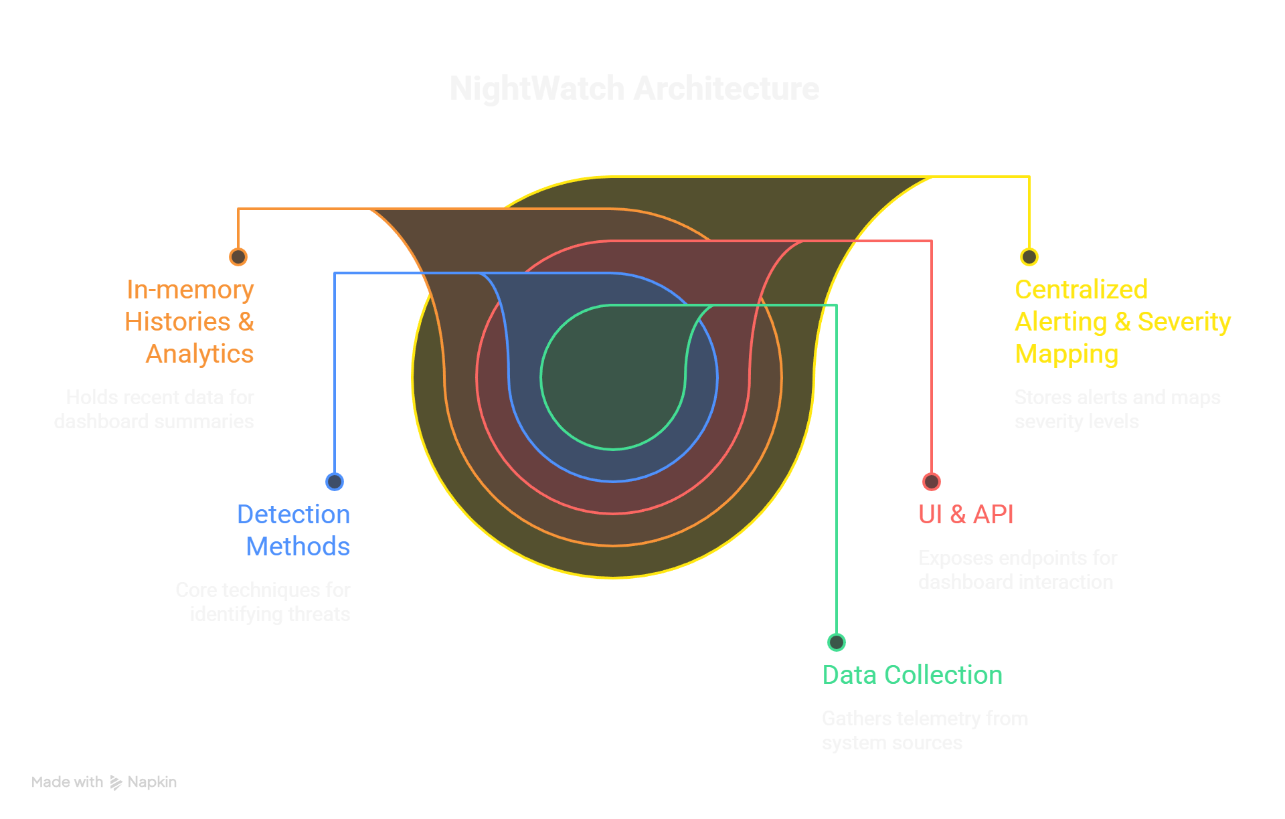
Architecture

Slide 9
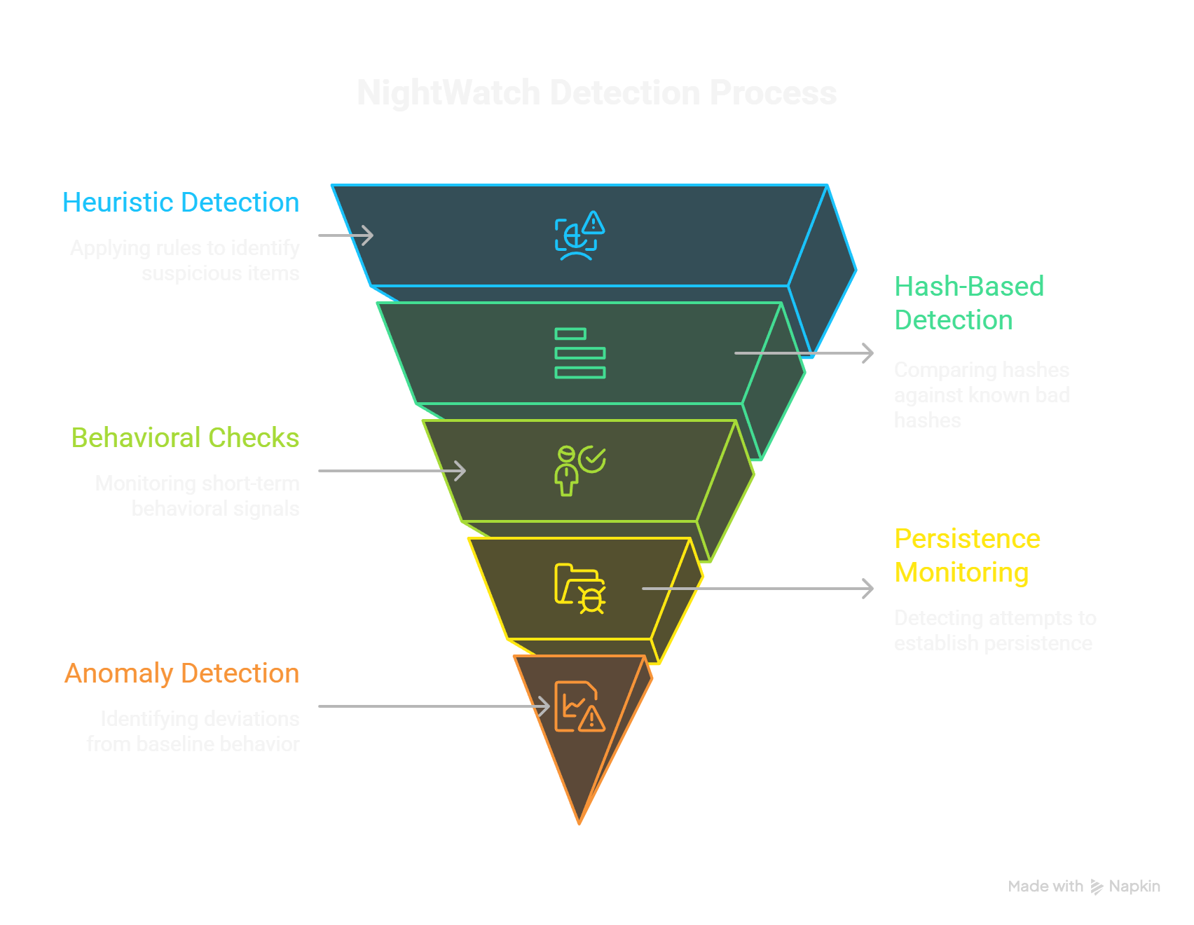
Detection Mechanism

Slide 10
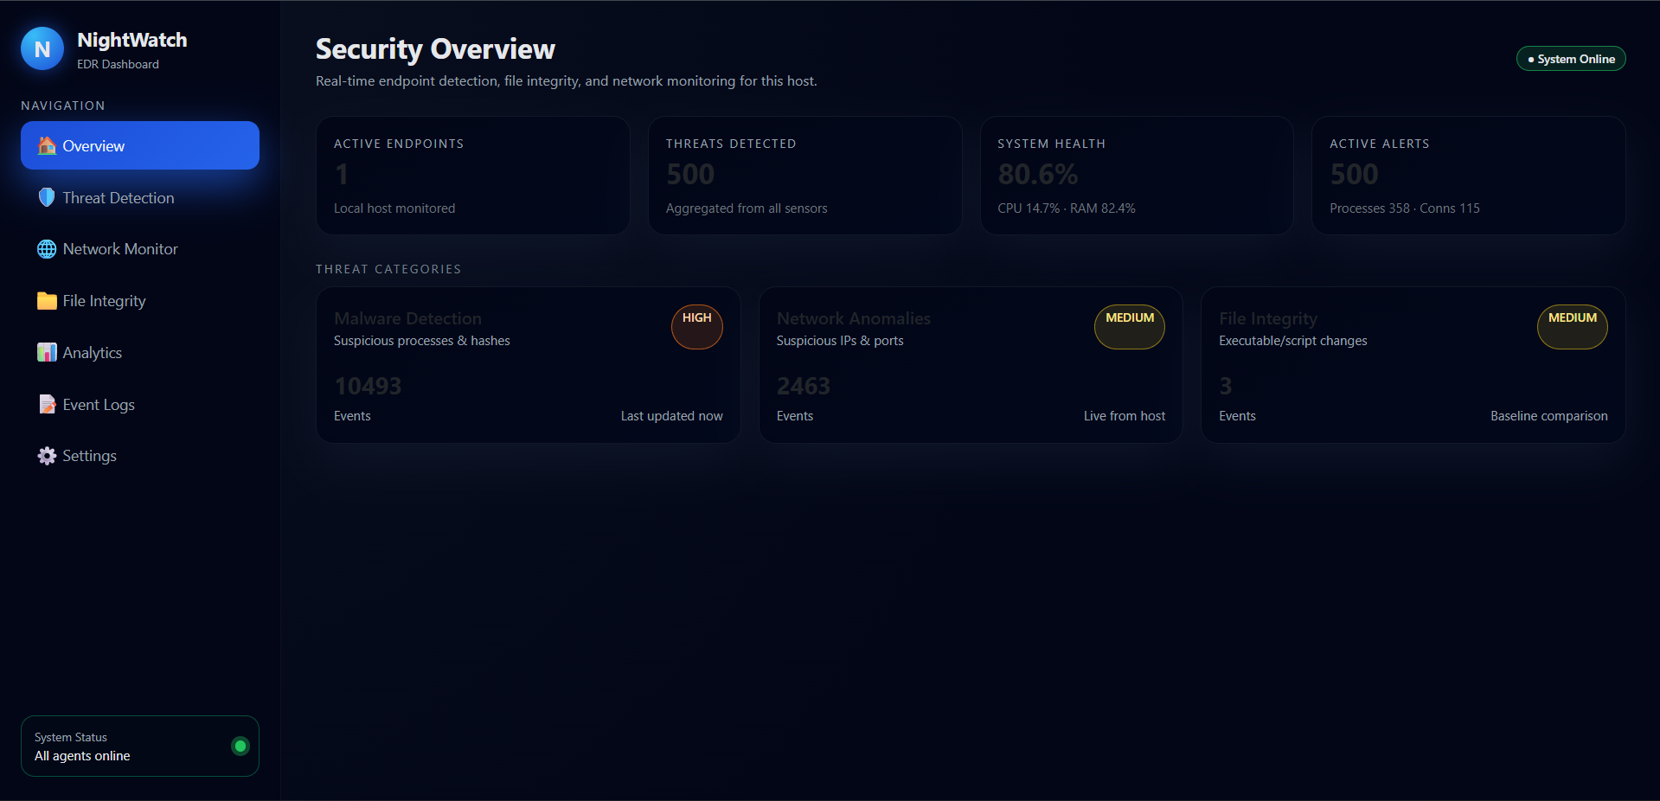
Dashboard Overview

Slide 11
Security &
Reliability
Reliability
Local event queue when offline
Graceful retry logic
Extensive logging on agent & server
Config-driven architecture
Security
Token-based authentication for agents
Sanitized dashboard output
Secure rule execution
HTTPS-ready server design

Slide 12
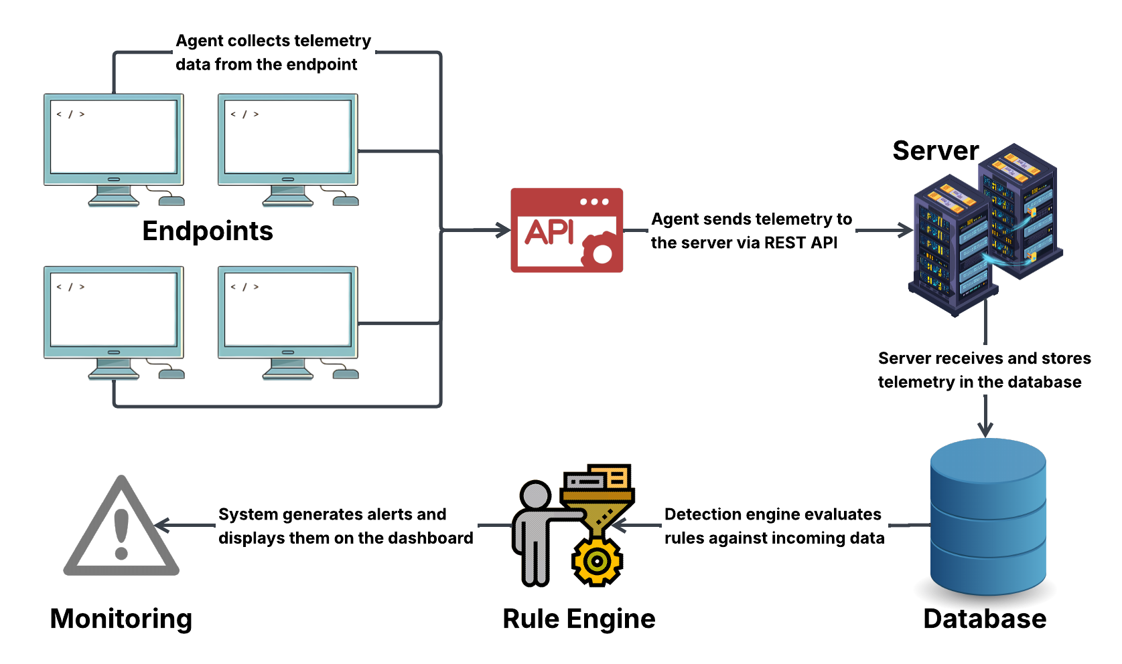
Flowchart

Slide 13
Conclusion & Future Scope
Future Scope
Machine Learning anomaly detection
Sysmon-level deep visibility
Kernel Driver Based Detection
Automated responses (quarantine, kill process)
Linux & macOS agent versions
Conclusion:
Fully functional Python-based EDR
Process/file/network/event log telemetry
Rule-based detection engine
Dashboard for alerts/endpoints/rules

Slide 14
THANKYOU

